Slide 1
BUILD YOUR FIRST MACHINE LEARNING MODEL WITH SCIKIT- LEARN AND PYTHON
Susan IBACH – Amazon Future engineer program lead, canada ibacsusa@amazon.com
@HOCKEYGEEKGIRL

Slide 2
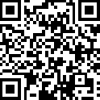
Get the code and try it yourself
tinyurl.com/FirstPythonModel

Slide 3
The machine learning process
Define the problem
Find the data
Explore the data
Clean and prepare the data
Put aside test data
Train the model
Test the model
Check accuracy
Repeat steps as necessary

Slide 4
Define the problem
Airlines are losing money due to flight delays

Slide 5
Find the data
US Department of Transportation open data sets

Slide 6
Explore the data
Features
Label
FL_DATE | CARRIER | TAIL_NUM | ORIGIN | DISTANCE | ARR_DELAY
2018-10-01 | WN | N221WN | ABQ | 378 | 15
2018-06-05 | DL | N8329B | DUL | 1325 | -3
2018-12-03 | AA | N227WN | BOS | 835 | 45

Slide 7
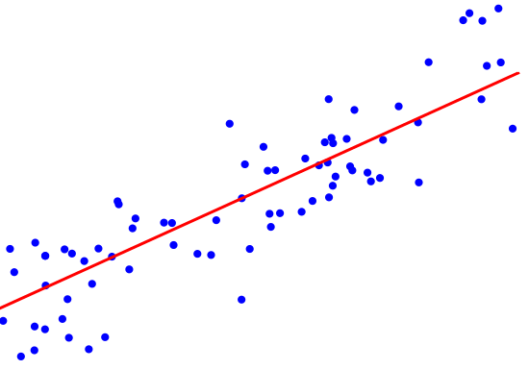
Select features (x) and label (y) to train your model
y
ARR_DELAY
x
DISTANCE

Slide 8
Clean and prepare the data
Missing values
FL_DATE | CARRIER | TAIL_NUM | ORIGIN | DISTANCE | ARR_DELAY
2018-10-01 | WN | N221WN | ABQ | 378 | 15
2018-06-05 | DL | N8329B | DUL | 1325
2018-12-03 | AA | N227WN | BOS |  | 45

Slide 9
Put aside test data
Training Data 70-80%
Original data set
Test Data 20-30%

Slide 10
Train the model Linear Regression
"y/label/
ARR_DELAY" increases
As "x/feature/DISTANCE" increases

Slide 11
Test the model
Test Data
FL_DATE | CARRIER | TAIL_NUM | ORIGIN | DISTANCE | ARR_DELAY
2018-10-01 | WN | N221WN | ABQ | 378 | 15
Trained Model
8

Slide 12
Check Accuracy
Test Data
FL_DATE | CARRIER | TAIL_NUM | ORIGIN | DISTANCE | ARR_DELAY
2018-10-01 | WN | N221WN | ABQ | 378 | 15
Trained Model
How close did
the model get
to the correct value?
8

Slide 13
Visualizing the trained linear regression model
Arr_delay
y = ax+b
Arr_delay = a*distance + b
a => slope/coefficient
b => intercept
intercept
Distance

Slide 14
If the accuracy is bad, start over!

Slide 15
QUESTIONS?
Susan IBACH Amazon future engineer program lead, canada ibacsusa@amazon.com
@HOCKEYGEEKGIRL

